Slide 1

Pipeline Hazards
There are situations, called hazards, that prevent the next instruction in the instruction stream from being executing during its designated clock cycle.
Hazards reduce the performance from the ideal speedup gained by pipelining.

Slide 2
There are three classes of hazards:
Structural Hazards
Data Hazards
Control Hazards

Slide 3
Structural Hazards
They arise from resource conflicts when the hardware cannot support all possible combinations of instructions in simultaneous overlapped execution.

Slide 4
Common instances of structural hazards arise when
  Some functional unit is not fully pipelined. Then a sequence of instructions using that unpipelined unit cannot proceed at the rate of one per clock cycle
  Some resource has not been duplicated enough to allow all combinations of instructions in the pipeline to execute.

Slide 5
Example1:
a machine may have only one register-file write port, but in some cases the pipeline might want to perform two writes in a clock cycle.

Slide 6
Example2:
a machine has shared a single-memory pipeline for data and instructions. As a result, when an instruction contains a data-memory reference (load), it will conflict with the instruction reference for a later instruction (instr 3):
Clock cycle number
Instr | 1 | 2 | 3 | 4 | 5 | 6 | 7 | 8
Load | IF | ID | EX | MEM | WB
Instr 1 |  | IF | ID | EX | MEM | WB
Instr 2 |  |  | IF | ID | EX | MEM | WB
Instr 3 |  |  |  | IF | ID | EX | MEM | WB

Slide 7
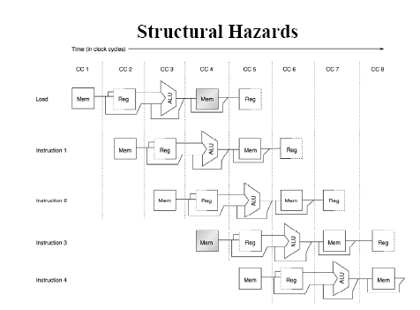

Slide 8
Example2:
To resolve this, we stall the pipeline for one clock cycle when a data-memory access occurs. The effect of the stall is actually to occupy the resources for that instruction slot. The following table shows how the stalls are actually implemented.
Clock cycle number
Instr | 1 | 2 | 3 | 4 | 5 | 6 | 7 | 8 | 9
Load | IF | ID | EX | MEM | WB
Instr 1 |  | IF | ID | EX | MEM | WB
Instr 2 |  |  | IF | ID | EX | MEM | WB
Stall |  |  |  | bubble | bubble | bubble | bubble | bubble
Instr 3 |  |  |  |  | IF | ID | EX | MEM | WB
Instruction 1 assumed not to be data-memory reference (load or store), otherwise Instruction 3 cannot start execution for the same reason as above.

Slide 9
Example2:
To simplify the picture it is also commonly shown like this:
Clock cycle number
Instr | 1 | 2 | 3 | 4 | 5 | 6 | 7 | 8 | 9
Load | IF | ID | EX | MEM | WB
Instr 1 |  | IF | ID | EX | MEM | WB
Instr 2 |  |  | IF | ID | EX | MEM | WB
Instr 3 |  |  |  | stall | IF | ID | EX | MEM | WB

Slide 10
Discussion
Introducing stalls degrades performance as we saw before. Why, then, would the designer allow structural hazards? There are two reasons:
To reduce cost. For example, machines that support both an instruction and a cache access every cycle (to prevent the structural hazard of the above example) require at least twice as much total memory.
To reduce the latency of the unit. The shorter latency comes from the lack of pipeline registers that introduce overhead.

Slide 11
Data Hazards
They arise when an instruction depends on the result of a previous instruction in a way that is exposed by the overlapping of instructions in the pipeline.

Slide 12
Example:
Data hazards occur when the pipeline changes the order of read/write accesses to operands so that the order differs from the order seen by sequentially executing instructions on the unpipelined machine.
 |  | 1 | 2 | 3 | 4 | 5 | 6 | 7 | 8 | 9
ADD | R1, R2, R3 | IF | ID | EX | MEM | WB
SUB | R4, R5, R1 |  | IF | ID_{sub} | EX | MEM | WB
AND | R6, R1, R7 |  |  | IF | ID_{and} | EX | MEM | WB
OR | R8, R1, R9 |  |  |  | IF | ID_{or} | EX | MEM | WB
XOR | R10,R1,R11 |  |  |  |  | IF | ID_{xor} | EX | MEM | WB

Slide 13
Explanation
All the instructions after the ADD use the result of the ADD instruction (in R1). The ADD instruction writes the value of R1 in the WB stage (shown black), and the SUB instruction reads the value during ID stage (ID_{sub}).
This problem is called a data hazard. Unless precautions are taken to prevent it, the SUB instruction will read the wrong value and try to use it.
The AND instruction is also affected by this data hazard. The write of R1 does not complete until the end of cycle 5 (shown black). Thus, the AND instruction that reads the registers during cycle 4 (ID_{and}) will receive the wrong result.
The OR instruction can be made to operate without incurring a hazard by a simple implementation technique. The technique is to perform register file reads in the second half of the cycle, and writes in the first half. Because both WB for ADD and ID_{or} for OR are performed in one cycle 5, the write to register file by ADD will perform in the first half of the cycle, and the read of registers by OR will perform in the second half of the cycle.
The XOR instruction operates properly, because its register read occur in cycle 6 after the register write by ADD.

Slide 14
Control Hazards
They arise from the pipelining of branches and other instructions that change the PC.

Slide 15
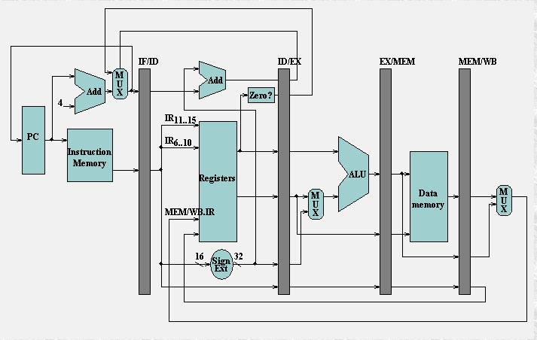
If instruction i is a taken branch, then the PC is normally not changed until the end of MEM stage, after the completion of the address calculation and comparison

Slide 16
Example & Solution:
The simplest method of dealing with branches is to stall the pipeline as soon as the branch is detected until we reach the MEM stage, which determines the new PC. The pipeline behavior looks like :
 | IF | ID | EX | MEM | WB
Branch successor |  | IF(stall) | stall | stall | IF | ID | EX | MEM | WB
Branch successor+1 |  |  |  |  |  | IF | ID | EX | MEM | WB
The stall does not occur until after ID stage (where we know that the instruction is a branch).

Slide 17
Discussion
Three clock cycles wasted for every branch is a significant loss. With a 30% branch frequency and an ideal CPI of 1, the machine with branch stalls achieves only half the ideal speedup from pipelining!
The number of clock cycles can be reduced by two steps:
  Find out whether the branch is taken or not taken earlier in the pipeline;
  Compute the taken PC (i.e., the address of the branch target) earlier.Both steps should be taken as early in the pipeline as possible.

Slide 18
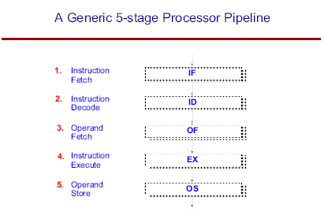
Extra Information

Slide 19
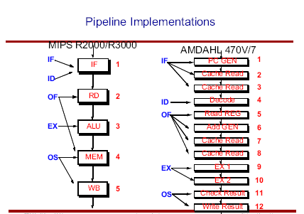
Extra Information

Slide 20
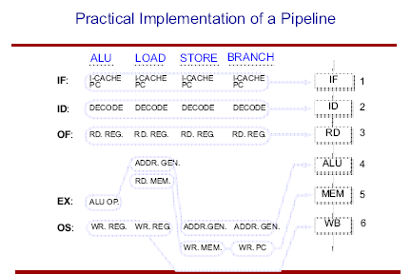
Extra Information

